Slide 1



Minor Project – 2
Cybersecurity Internship at Naviotech Solution
DD/MM/YYYY

Slide 2



Zero Trust Architecture for Enterprise Security
Traditional perimeter-based security assumes trust inside the network, but modern enterprises face risks from remote work, cloud services, and insider threats
Zero Trust Architecture eliminates implicit trust and enforces security verification at every access request
Objective: Design and simulate a Zero Trust security framework for enterprise environments

Slide 3
CORE CONCEPT
Never Trust, Always Verify
KEY PRINCIPLES
Verify Identity
Verify identity before granting access to any resource
Least Privilege
Grant minimum access needed with continuous monitoring
Assume Breach
Operate with assumption that systems may be compromised
Minimize Attack
Reduce attack surface and prevent lateral movement

Slide 4

Authentication Models
Multi-Factor Authentication (MFA)
Requires multiple proofs: Password, OTP, Biometric
​
Protects against credential theft
Role-Based Access Control (RBAC)
Access granted based on job roles
​
Admin → Full access Employee → Limited access Guest → Read-only access

Slide 5

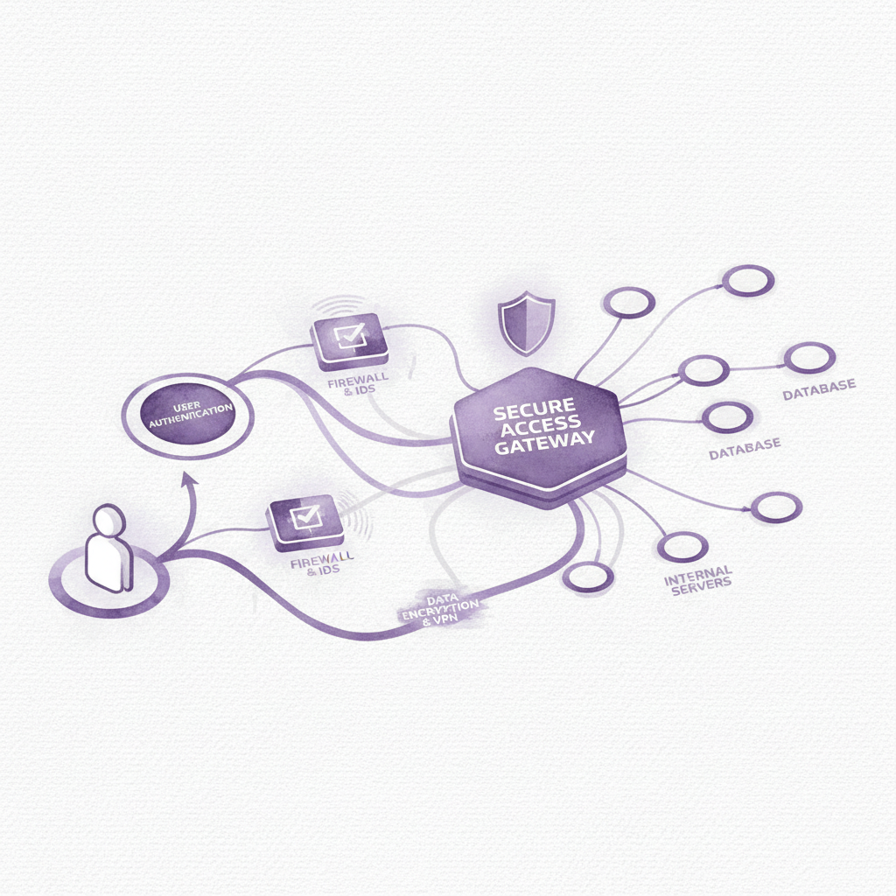
Zero Trust Framework Design
Identity & Access Management
IAM controls user authentication and authorization across all resources
Device Verification
Validates device health and compliance before granting access
Micro-segmentation
Isolates network segments to contain threats and limit lateral movement
Encrypted Communication
Secures all data in transit with end-to-end encryption protocols
Architecture Flow: User → Identity Verification → Policy Check → Secure Access

Slide 6
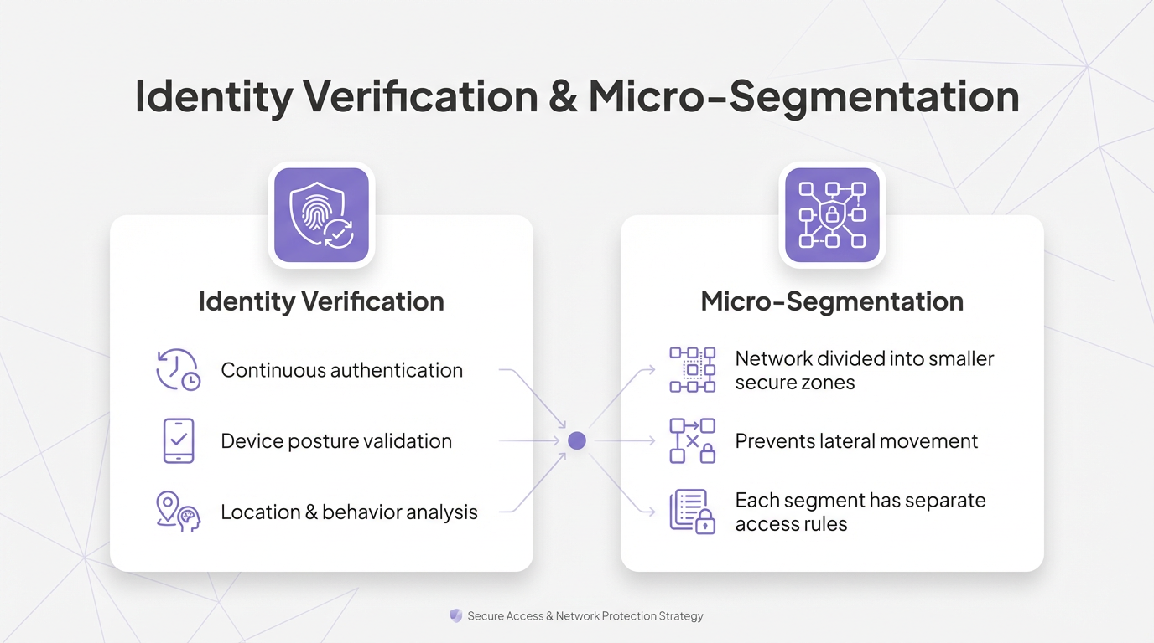

Slide 7
LAB SETUP
Virtualized Enterprise Simulation
Tools Used
VM 1: Identity Provider
VM 2 & 3: Core Systems
VM 4: Attacker Simulation
VMware / VirtualBox
Docker Containers
IAM Server for authentication and authorization
Employee System
Secure Application Server
Test Zero Trust controls in real-world scenarios

Slide 8


IAM & Access Control Policies
IAM
POLICIES
SECURITY
IAM Implementation
Access Policy Example
Encryption
User authentication, role assignment, and policy enforcement
TLS for data in transit, encrypted storage for credentials
MFA mandatory for admin access, employees restricted to assigned applications, unauthorized users denied access

Slide 9
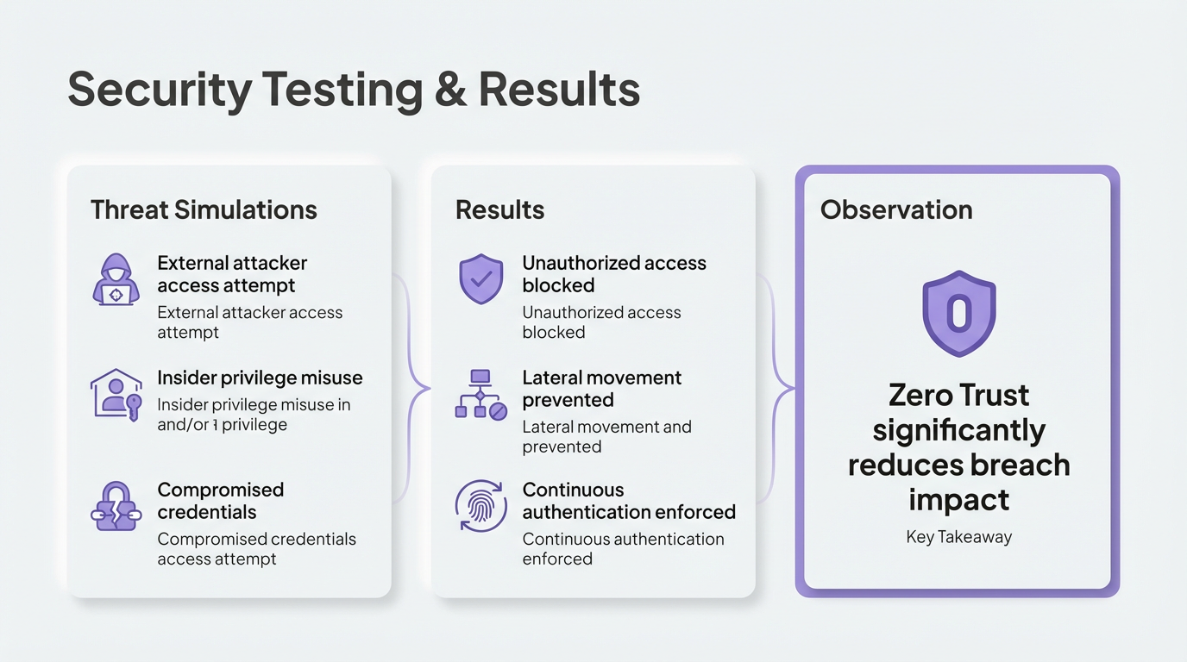

Slide 10


Enhanced Protection
Conclusion & Future Improvements
Zero Trust architecture provides robust defense against modern cyber threats through continuous verification.
Zero Trust strengthens enterprise security by eliminating implicit trust, proving effective against modern cyber threats.
Proven Effectiveness
Successfully addresses security challenges by removing implicit trust assumptions from network architecture.
Thank you
Future Ready
Zero Trust strengthens enterprise security
Scalable framework that adapts to evolving threat landscapes and organizational growth.
Eliminates implicit trust

